Slide 1

PhonePe Data Visualization Dashboard
Business Intelligence & Digital Payment Analytics Using Power BI
Prepared By: AYUSH DASH
Date: 24th June, 2026

Slide 2
01
Project Overview
02
Data Architecture & Preparation
03
DAX Measures & Analysis
CONTENT
04
Interactive Dashboards
05
Business Insights & Recommendations
06
Project Impact & Future Scope

Slide 3
Project Overview
/
01

Slide 4
Executive Summary
Project Scope
Business Value
The project transforms raw PhonePe transaction and user data into an interactive dashboard to analyze digital payment trends, user growth, state- and district-level performance, and transaction categories.
The dashboard serves as a centralized platform for monitoring India's digital payment ecosystem, enabling data-driven decision-making for stakeholders.

Slide 5
Business Problem & Objectives
Core Objectives
Proposed Solution
The project targets transaction analytics (value, volume, categories), user analytics (registrations, brand adoption, growth), regional analytics (state/district comparison), and executive reporting.
Key Challenges
A scalable Power BI dashboard with KPIs, geographic analysis, rankings, and trend monitoring was developed to address these challenges.
PhonePe faces difficulties in identifying top-performing regions, monitoring transaction growth, tracking user adoption, and generating actionable insights from large data volumes.

Slide 6
Data Architecture & Preparation
/
02

Slide 7
Dataset Architecture
Dataset Table
Dataset | Purpose
Aggregated Transaction | Transaction KPIs
Aggregated User | User KPIs
Map Transaction | Geographic Analysis
Map User | Geographic User Analysis
Top Transaction | Top District Analysis
Top User | Top User Analysis

Slide 8
Data Preparation
ETL & Data Cleaning
Data Modeling
Power Query operations included importing CSV datasets, data type validation, null value checking, column standardization, relationship creation, and data transformation. Result is a clean, optimized dataset ready for analytics.
Fact tables (Transaction, User) and dimension tables (State, District, Time, Transaction Type) were designed for faster report performance, consistent calculations, and efficient filtering.

Slide 9
DAX Measures & Analysis
/
03

Slide 10
Core Measures
Total Registered Users
`= SUM(aggregated_user[RegisteredUsers])`
Total Transaction Amount
Average Transaction Value
`= SUM(aggregated_transaction[Transaction_amount])`
`= DIVIDE([Total Transaction Amount], [Total Transactions])`
Total Transactions
Total App Opens
`= SUM(aggregated_transaction[Transaction_count])`
`= SUM(aggregated_user[AppOpens])`

Slide 11
Advanced Measures
Top Transaction & Users
Extracted maximum transaction and user values for top-performing districts.
1
State & District Rankings
State Rank and District Rank measures use `RANKX` to provide performance rankings across geographic levels.
3
2
Brand Market Share
Calculated as `DIVIDE([Brand Users], [Total Brand Users])` to analyze mobile brand adoption.

Slide 12
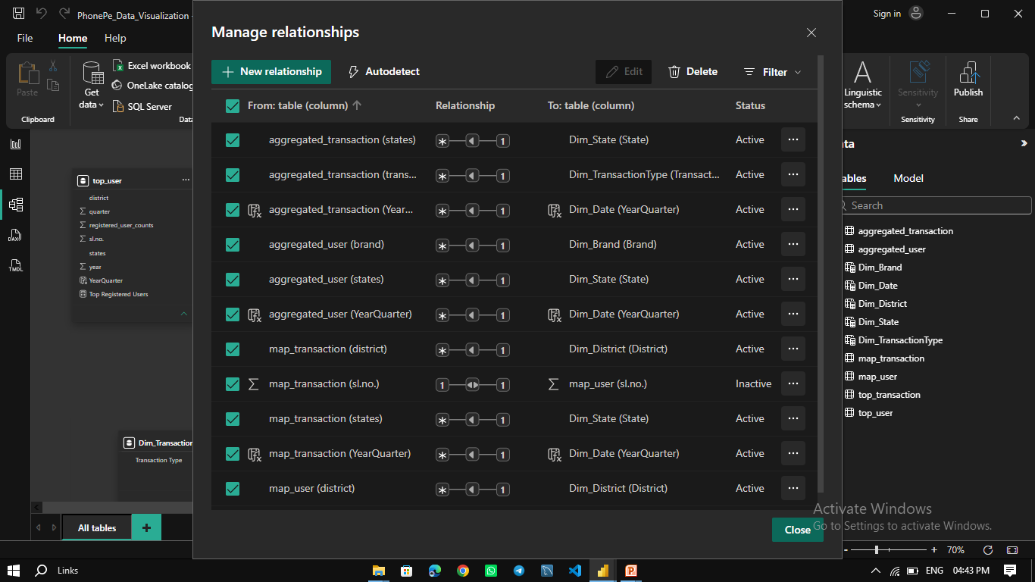
Relationship Screenshot
/

Slide 13
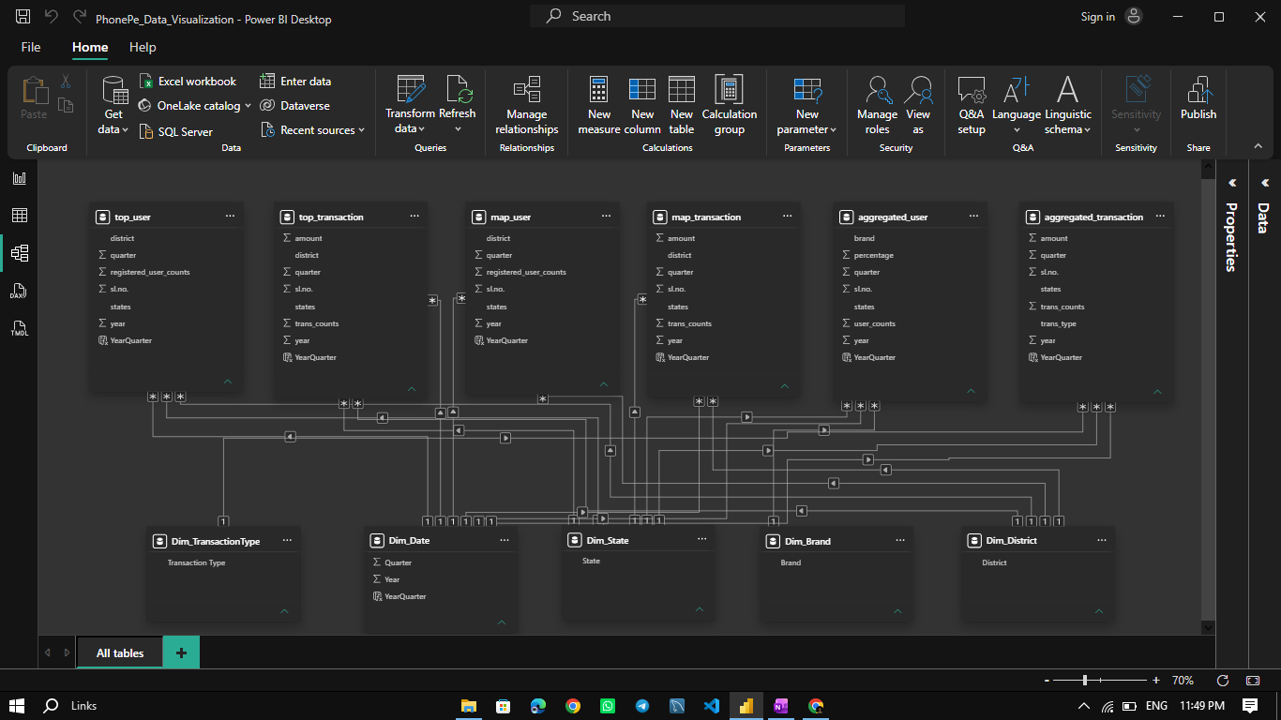
Model View Screenshot
/

Slide 14
Interactive Dashboards
/
04

Slide 15
Executive Overview Dashboard
Visual Components
KPI cards, India map, navigation buttons, and an executive summary section.
Key KPIs
Transaction Value = 121.41T, Transactions = 72 Billion, Users = 5 Billion, Brands = 3 Billion. These provide an instant view of platform performance.

Slide 16
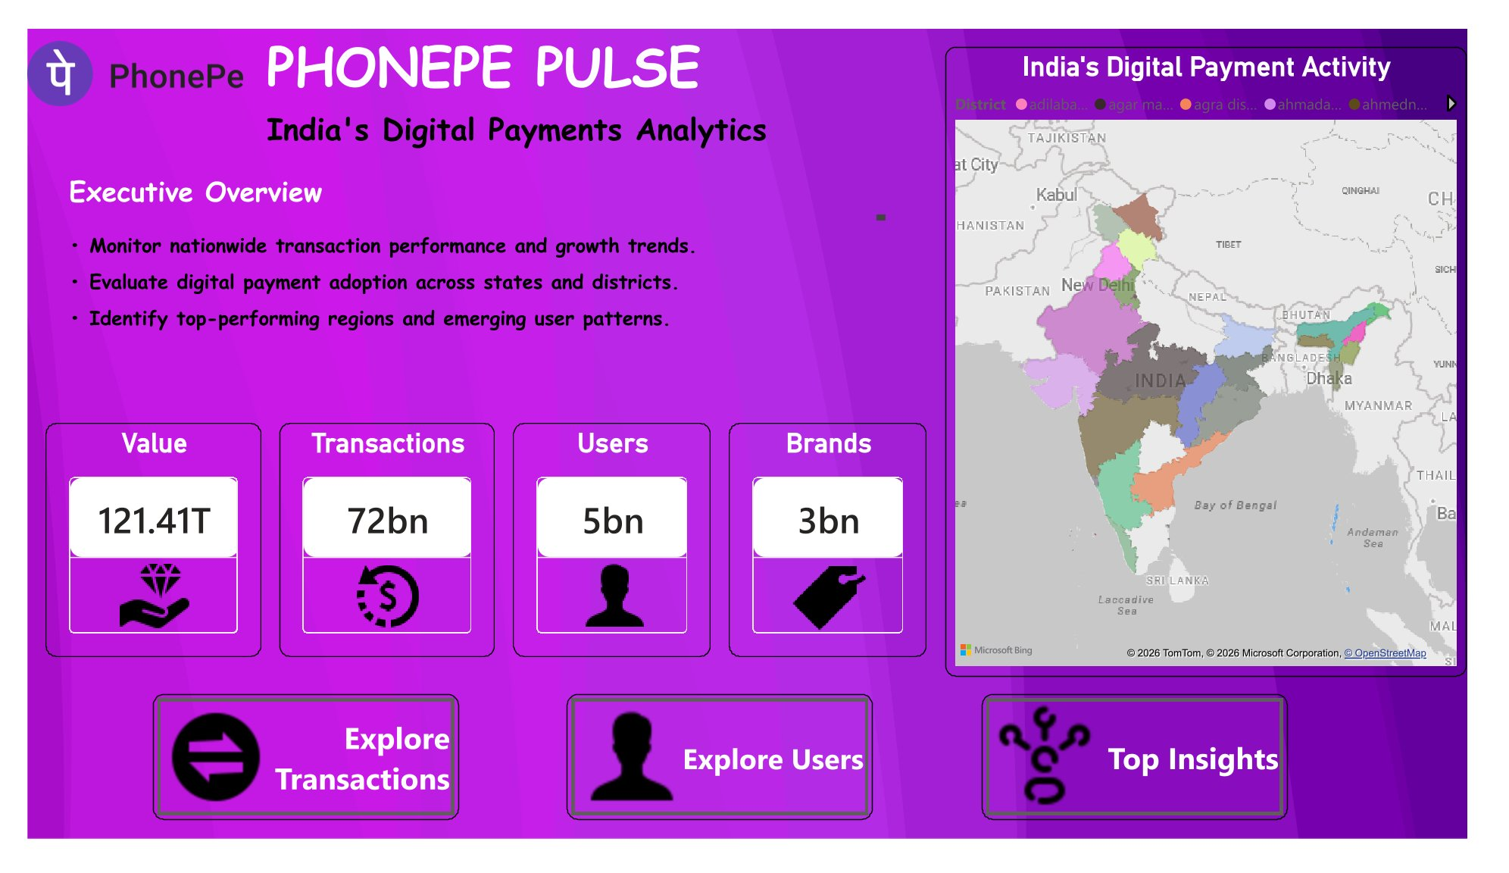
Executive Overview Screenshot
/

Slide 17
Transaction Analysis Page
01
02
03
Key Metrics
Visualizations
Business Questions
Total Transaction Value = 121.41T, Total Transactions = 72B, Average Transaction Value = 1.69K, Active States = 36.
State-wise transaction map, quarterly trend analysis, transaction type distribution, top 10 states, top 10 districts.
Which states contribute most value? Which districts lead? How have transactions grown over time?

Slide 18
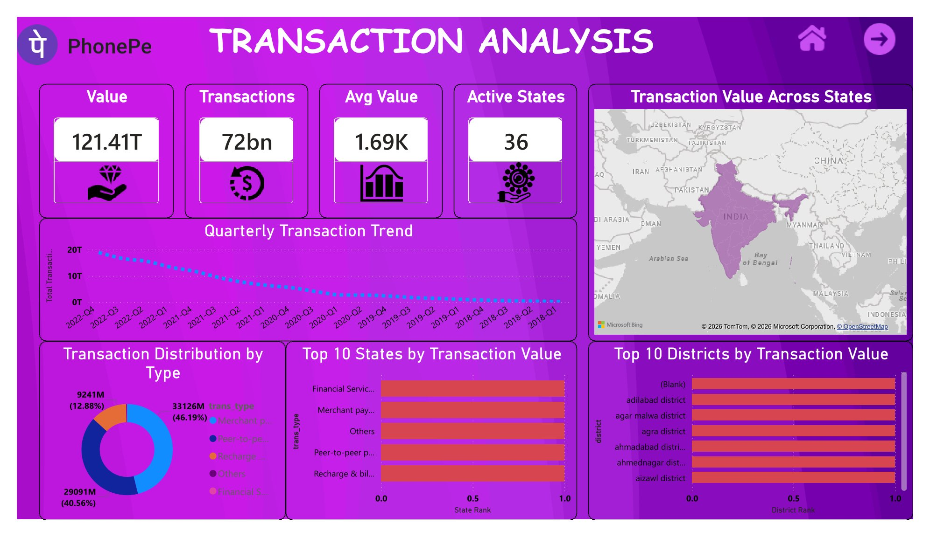
Transaction Analysis Screenshot
/

Slide 19
User Analysis Page
Key Metrics
Visualizations
Registered Users = 5 Billion, Brand Users = 3 Billion, Brand Market Share Analysis.
Registered users by state, mobile brand distribution, quarterly user growth, top districts by users.

Slide 20
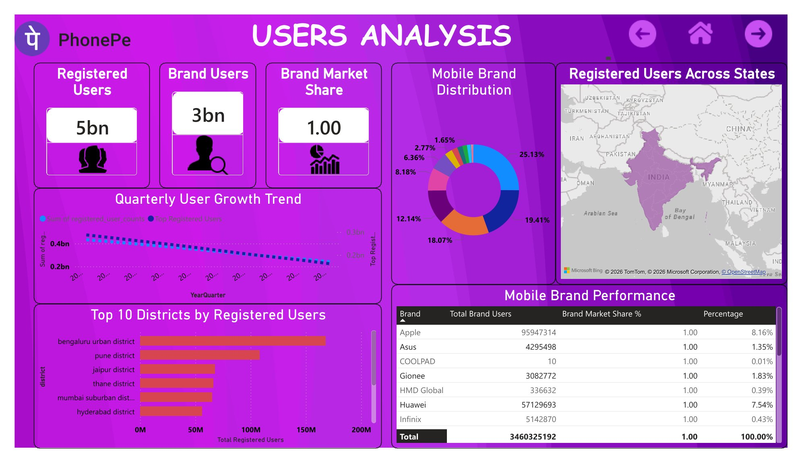
User Analysis Screenshot
/

Slide 21
Mobile Brand Performance Table
Brand Market Share
Brand | Market Share (Illustrative)
Apple | Data available in dashboard
Huawei | Data available in dashboard
Asus | Data available in dashboard
Infinix | Data available in dashboard
Others | Data available in dashboard

Slide 22
Top Insights Page
KPIs
Top Transaction Value = 93.25T, Top Users = 3 Billion.
Visuals
Strategic Importance
Top states by transaction value, top districts by users, transaction volume vs value, state performance ranking.
Helps identify high-performing states, high-value districts, market leaders, and growth opportunities.

Slide 23
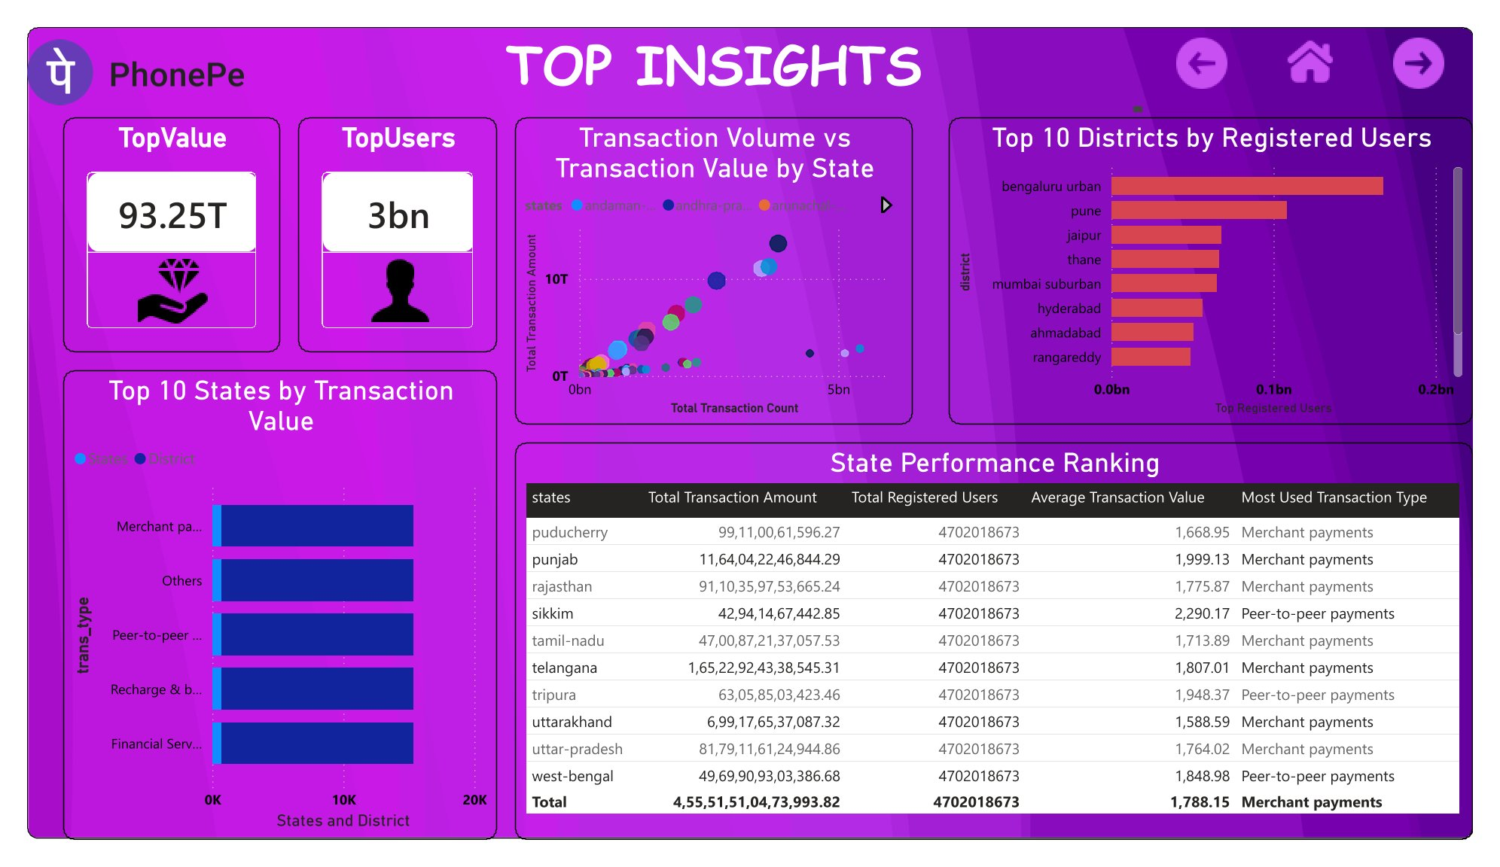
Top Insights Screenshot
/

Slide 24
Business Insights & Recommendations
/
05

Slide 25
Key Business Insights
Geographic Insights
Regional differences reveal strong concentration of digital payment activity.
User Insights
Transaction Insights
User registrations increase steadily; leading districts include Bengaluru Urban, Pune, Jaipur, and Thane.
Merchant Payments dominate transaction categories; transaction value has grown consistently across quarters; certain states contribute a significantly larger share.

Slide 26
Business Recommendations
Market Expansion
Customer Growth
User Engagement
Focus campaigns on low-performing states.
Target districts with lower user penetration.
Introduce region-specific reward programs.
Data Monitoring
Product Strategy
Track quarterly transaction growth continuously.
Use mobile brand analytics for targeted partnerships.

Slide 27
Project Impact & Future Scope
/
06

Slide 28


Business Benefits Delivered
Centralized Reporting
Technical Skills Demonstrated
Single platform for KPI monitoring, regional analysis, user growth tracking, and interactive data exploration.
Power BI, Power Query, DAX, Data Modeling, Data Visualization, Business Intelligence.

Slide 29

Future Enhancements
Planned Improvements
Real-time data refresh, predictive analytics, forecasting models, AI-based insights, customer segmentation, and fraud detection dashboard.

Slide 30
Thank You

